Slide 1
Java EE – Introduction

Slide 2
What is Java EE?
Java Enterprise Edition (Java EE, formerly called J2EE or Java 2 Enterprise Edition) is a standard set of technologies and APIs for server-side Java development.

Slide 3
API?
An application programming interface (API)
is a set of routines, protocols, and tools for building software applications
expresses a software component in terms of its operations, inputs, outputs, and underlying types.
defines functionalities that are independent of their respective implementations, which allows definitions and implementations to vary without compromising each other.

Slide 4
Java EE APIs
JavaServer Faces (JSF)
Java Database Connectivity (JDBC)
Enterprise JavaBeans (EJBs)
Java Messaging Service (JMS)
Java Persistence API (JPA)
Java API for WebSocket
Contexts and Dependency Injection (CDI)
Java API for XML Web Services (JAX-WS)
Java API for RESTful Web Services (JAX-RS)
Java API for JSON Processing (JSON-P)

Slide 5
Java EE APIs
JavaServer Faces (JSF)
Java Database Connectivity (JDBC)
Enterprise JavaBeans (EJBs)
Java Messaging Service (JMS)
Java Persistence API (JPA)
Java API for WebSocket
Contexts and Dependency Injection (CDI)
Java API for XML Web Services (JAX-WS)
Java API for RESTful Web Services (JAX-RS)
Java API for JSON Processing (JSON-P)

Slide 6
Java EE
Tomcat, Jetty (web container)
Glassfish, WebSphere (full container)
platform This is the set of API specifications that are the building blocks of the web application.
container The container implements the API specifications of the Java EE platform
components These are hosted by the container.
Java Server Pages
Servlets
Web Services

Slide 7
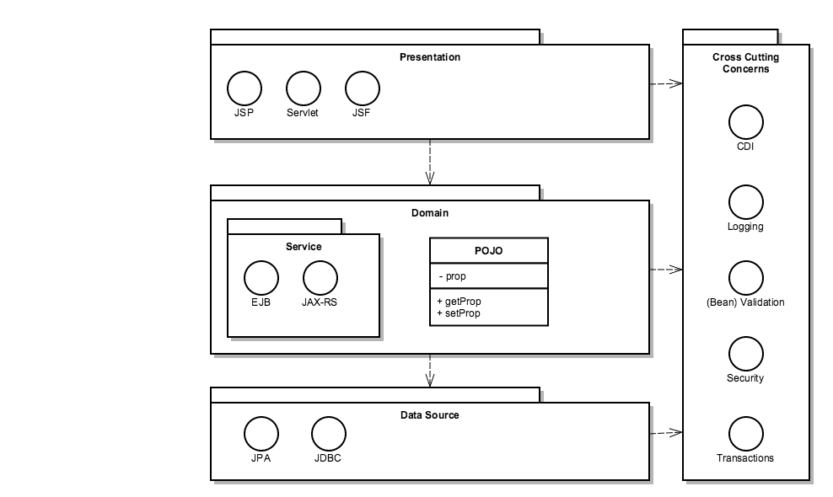
Java EE Platform architecture

Slide 8
Java EE Containers
Web Profile
Servlet
JSF
EJB
JPA
JSP
CDI
JTA
Bean Validation
Full Java EE = Web Profile +
JAX-RS
JNDI
JavaMail
RMI
JAXB
Notes:
Wij gebruiken in deze course alleen de rode

Slide 9
Java EE Platform architecture
Notes:
Wij gebruiken in deze course alleen de rode

Slide 10
Containers in AppServers
Containers deliver clients and components “Quality Of Service”:
Clustering
Cloning
Routing
Failover
Session persistence
Load balancing
Thread / connection pooling
Datasources

Slide 11
Java EE Container of choice: Apache Tomcat
Contains Apache HTTP server but adds Web Profile APIs for dynamic web apps
Misses JAX-RS but can be extended with an JAX-RS implementation, e.g. Jersey

Slide 12
Demo(‘s)
Java EE Sample Applications
Notes:
In NetBeans zitten enkele voorbeeldprojecten die weliswaar op Glassfish draaien maar die wel de essentie van Java EE laten zien:
WebJPA
ServletStateless
REST: Hello World

